Slide 1
WAD2 Group Project
Team 10-D

Slide 2
Project Overview
Users will be able to view albums
Authenticated users will be able to like/dislike, comment on and upload albums
The home page will show top rated albums, albums uploaded that day, and a search feature for users/albums
A “follow” system- users will be able to follow other users, and albums they rate will show in the home page

Slide 3

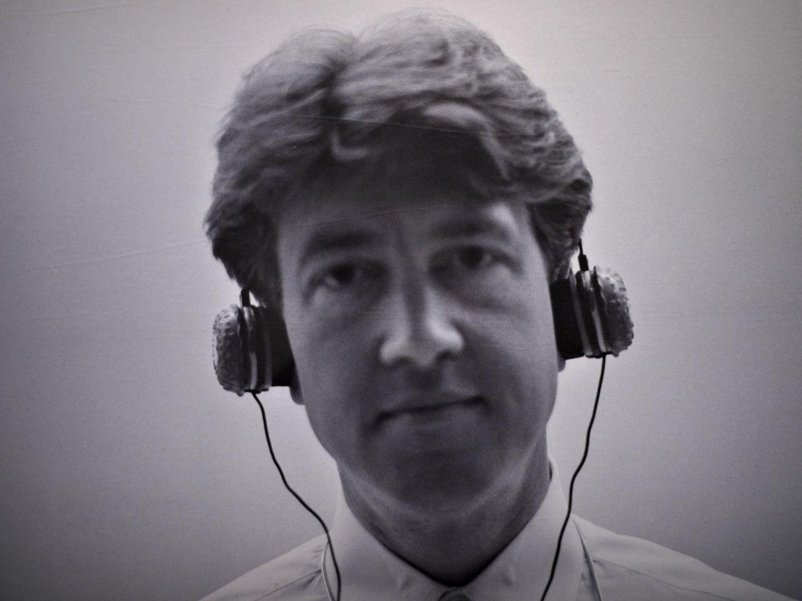
User Personas
Casual Listener Derek:
Description: Derek loves listening to music, but he doesn't have time to search deeply for new releases.
Goal: He wants to find new albums, and quickly rate and read reviews from other users.
Tasks:
Convenient search for albums, sort them by popularity/dates.
Keep track of what his friends like.

Slide 4
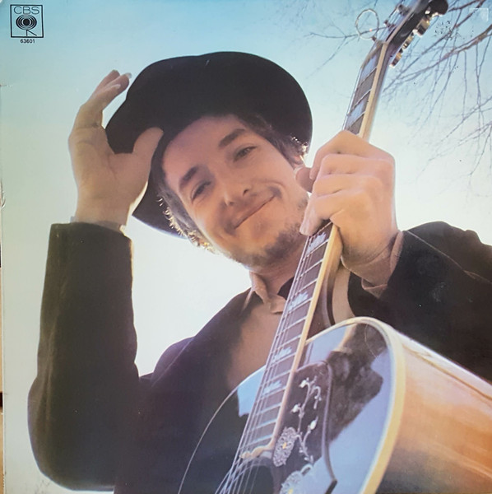
User Personas
Content Creator Evan:
Description: Evan is an aspiring musician, who records his own tracks and wants to share them with the community.
Goal: He wants to upload his albums, and get feedback and a fan base.
Tasks:
Easy upload albums and covers.
Ability to track statistics (number of likes, views and reviews).
Get fan feedback from reviews

Slide 5

User Personas
Music Critic Jared:
Description: Jared is an experienced music lover, he runs a blog and loves to give detailed reviews of music.
Goal: He wants to search for rare/interesting albums, and comment on them in detail.
Tasks:
Ability to find albums by genre and other metadata.
Write detailed reviews for each album.

Slide 6
Project Specification
Specification | Description
Registration and authorisation | The user can create an account using a login and password. Authenticated users have access to rate, review and upload album features.
User profile | Display basic information: username, registration date, uploaded albums, etc. Ability to change password and some settings.
Albums uploading | Fields when uploading: Album title, Cover, Genre, Release Date (defaults to current date) and Description (optional). Tracking upload date, views, score.
Like/dislike system | Each album can be rated out of 5 stars The average rating is displayed next to each album.
Review system | Ability to leave text reviews and scores under the album. Display a list of all reviews in chronological order.
The mechanics of “Followers” | Users can follow each other. The Home page displays the latest ratings from people you follow.
Search and sort | Full text search by album title and username. Filter by score, upload date, popularity.
Views | Each time you open an album page the view counter increases. Using cookies or sessions to avoid “cheated” views from the same user in a short period of time.

Slide 7
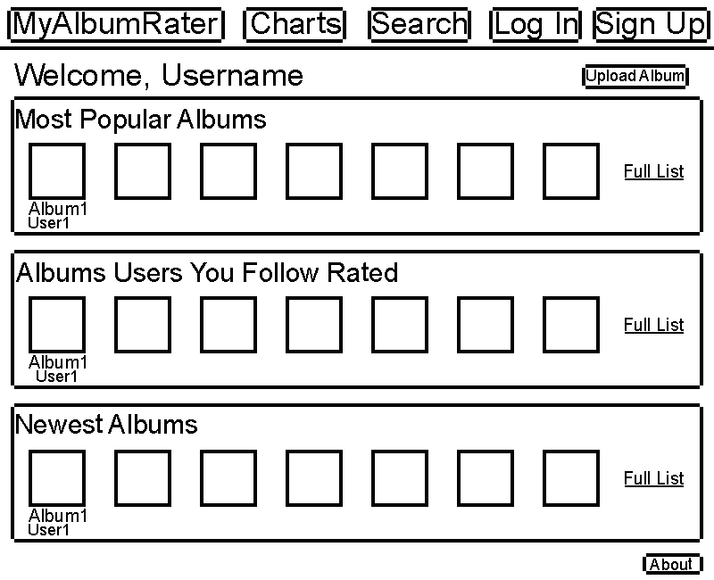
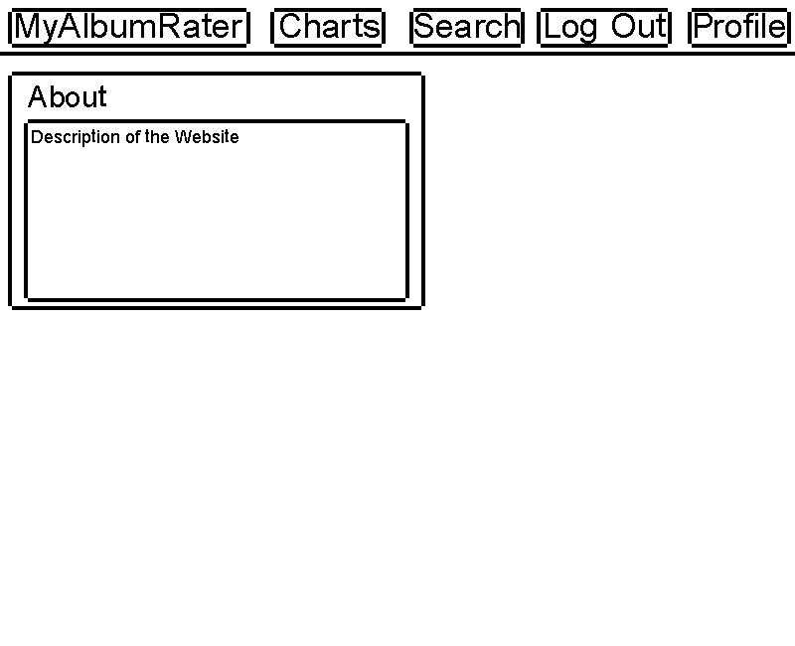
Wireframes – Home, About pages

Slide 8
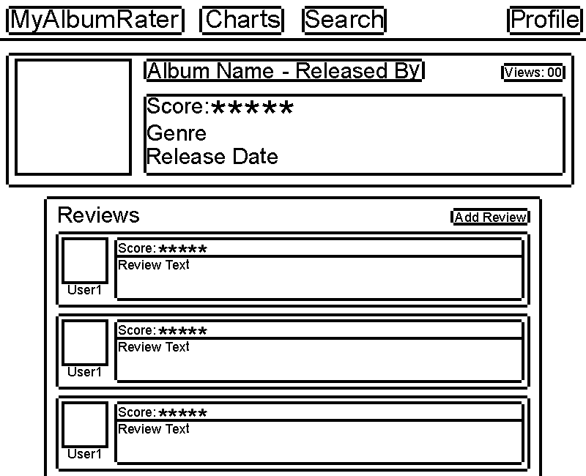
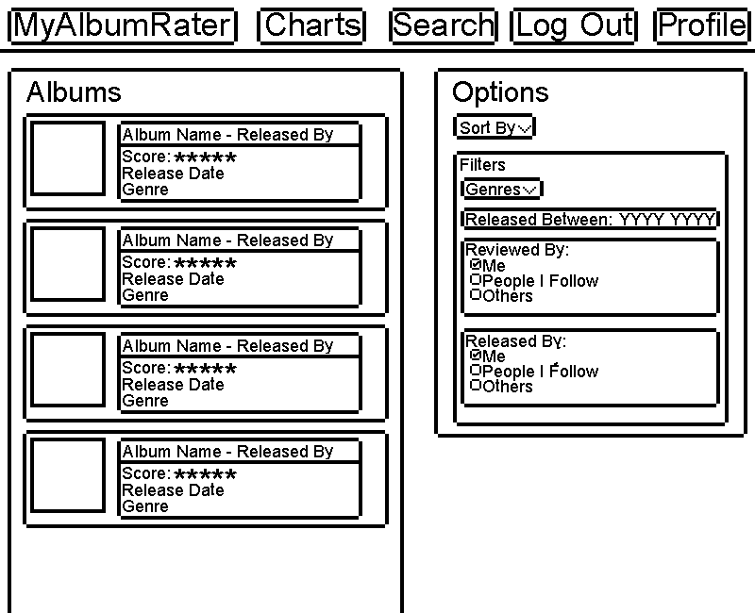
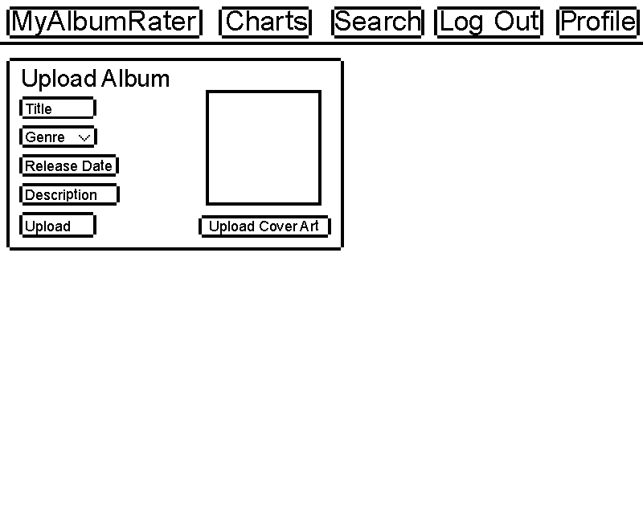
Wireframes – Album, search, upload album pages

Slide 9
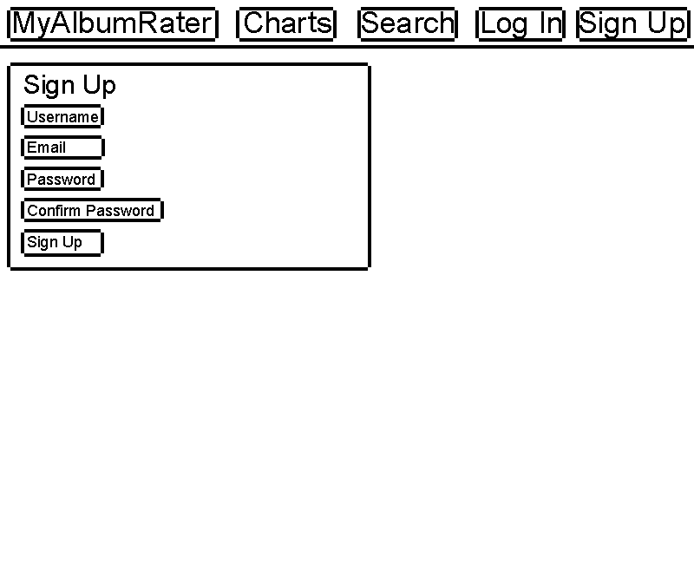
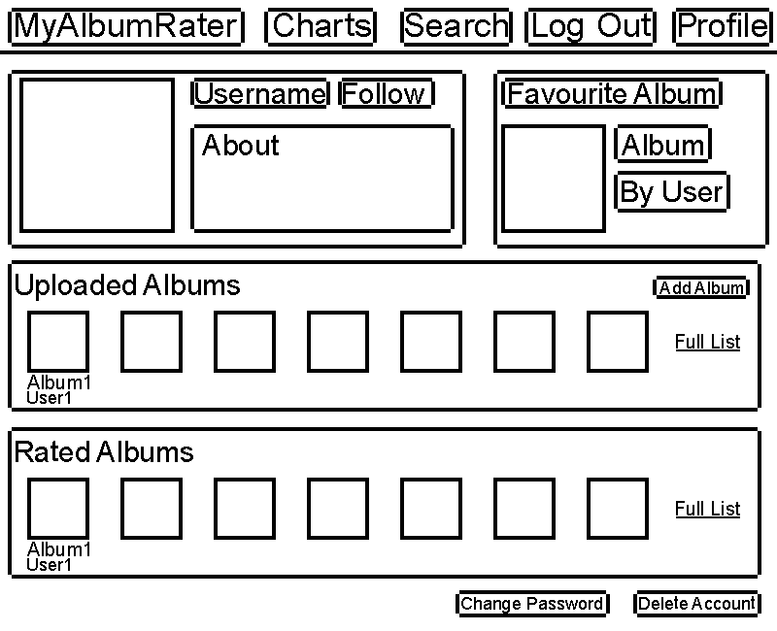
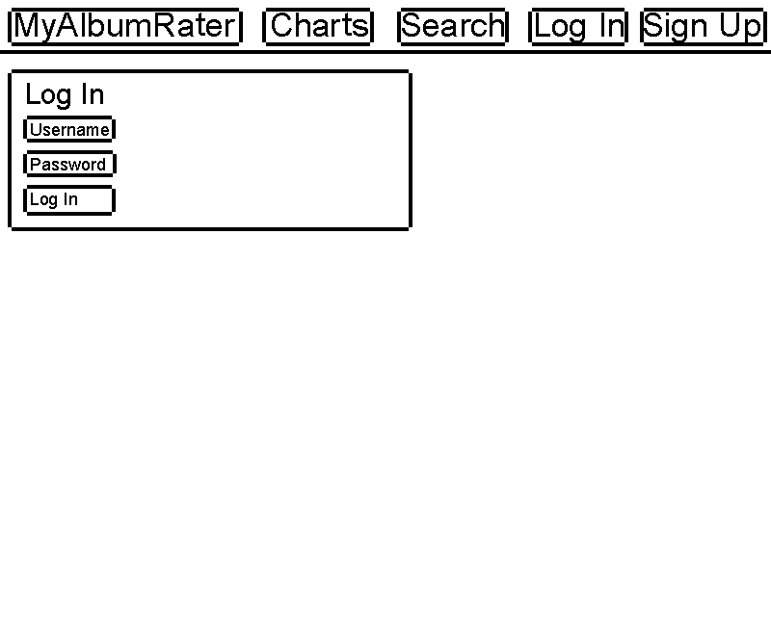
Wireframes – User page, log in, sign up

Slide 10
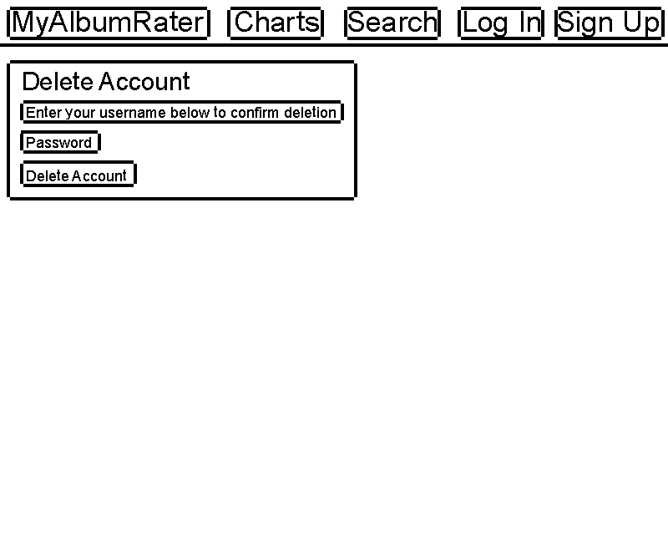
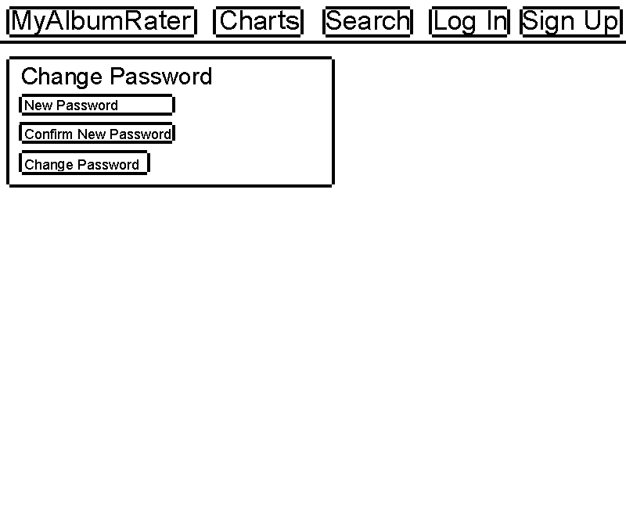
Wireframes – Delete account, change password

Slide 11
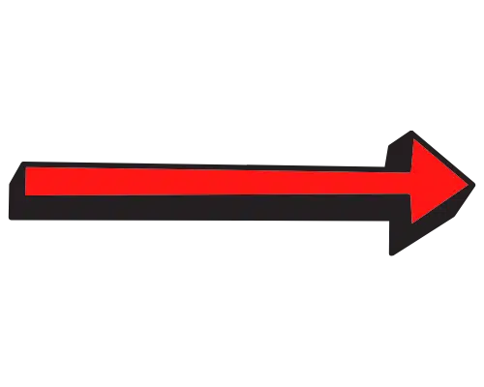



System Architecture Diagram
Model
URL
View
User
Web browser
DJango
Template

Slide 12
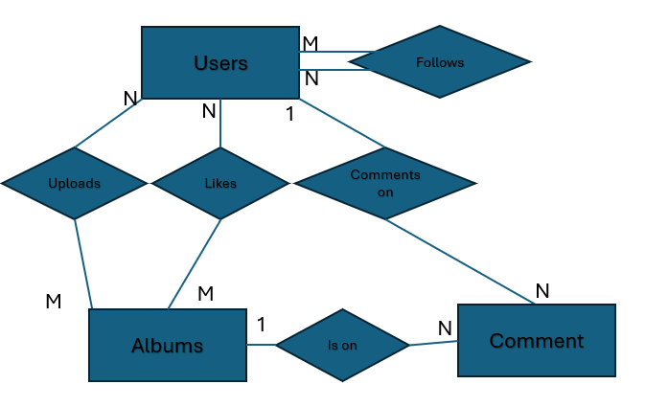
ER diagram
Users
Albums
Fields | Type
Username | Char(20)
DateCreated | Date
FavouriteAlbumId | Integer
Followers | Integer
Following | Integer
Fields | Type
Id | Integer
Title | Char(40)
Rating Score | Float
CoverArt | Image
UploaderUsername | Char(20)
UploadDate | Date
Views | Integer
Genre | Char(40) Dropdown?
1
Comments
Fields | Type
Id | Integer
Text | Char(255)
Username | Char(20)
AlbumId | Integer
Score | Integer

Slide 13
Site map
Home Page
Sign Up
Login
User Pages
About
Album Pages
Search
Delete Account
Change Password
Logout
Create Album

Slide 14
URL DESIGN
Home page - /index
About Page - /about
Sign Up - /account/register
Login - /account/login
Logout – /account/logout
Change Password - /account/password-change
Delete Account - /account/delete-account
User Pages - /user/<Users.Username>
Album Pages - /album/<Albums.AlbumTitle>
Create Album - /album/create
Search/Filter/Sort Page - /search

